Slide 1


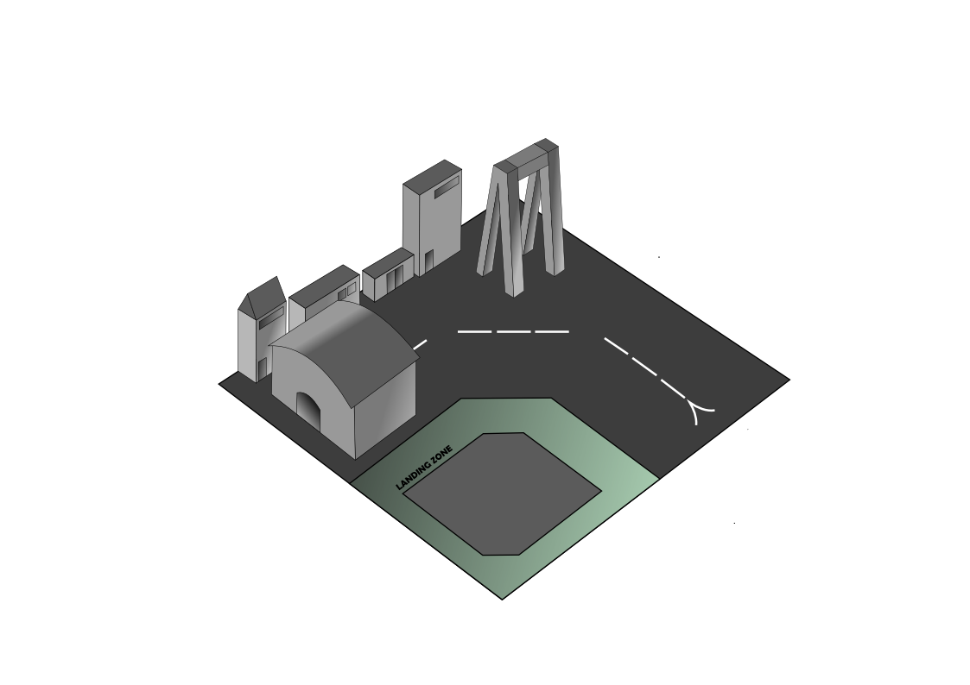
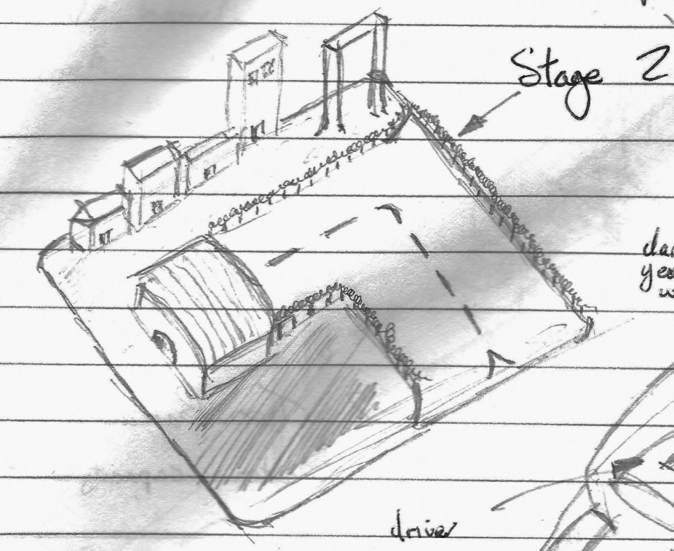
By Mat Perry and John Greenslade
(Unofficial Logo)
Concept Art - Resource Pad
Graphic Art By: John Greenslade

Slide 2

The Story / Background
By the middle of the 21st century Mankind had exhausted the resources of Earth and renewable sources of energy had proven to not be sustainable alternative. A third world war ensued causing the nations of earth to fight for control of the remaining resources still available. Eventually Humanity was forced to forge a new one world government to ensure the survival of the species, and so by the end of the century with a new renewed interest in space exploration a program was started to ensure the continuation of Humanity. A planet was discovered with a similar habitat to that of Earth and a group of colonists were sent to start anew, the planet would soon become to be known as Eden.
By the year 2140 the majority of the planet had be colonised and tensions had started to strain relations between Earth and Eden. It became clear Eden was being exploited for its rich, abundant resources known as “Eridium” to fuel Earths economy and soon revolution was on the horizon, the colonists were looking for independence from the old world. Riots broke out, Earth embassies where destroyed and all colonists which were known to have directly originated from Earth where executed in mass on public display. There was no turning back now, so much hatred had been suppressed by the colonists and this erupted into complete anarchy. Earth's government dispatched an immense fleet of military grade ships to quench the conflict but Eden was ready for such a planned invasion. By the time the fleet had entered Eden's solar system defensive countermeasures had been put in place on the surrounding moons of the planet. What followed was complete annihilation of the Earth fleet and after such a victory the inhabitants of Eden where not only in control of their home planet, but more importantly their rich, abundant resources “Eridium”.
Beyond this point all contact with Earth is lost & a new government is placed in power which would soon become to be known as The Republic of Eden (ROE). Another 3 decades pass and leaders of Eden's government squabble for the control of a crumbling nation. Soon the ROE completely dissolves and from this 3 new factions arise to fight for control of Eden.

Slide 3
Game Overview
Name: Eden Rising
Genre: Static Strategy Massive Multiplayer Online (MMO)
Platform: Web Browser (Internet Explorer, Firefox, Google Chrome etc.)
Game Access: To access the online game the user must visit the official game website and then sign up for an account in order to gain access to the game. After signing up a player profile will be generated from the data that the user has inputted during the registration process, in which will be available for other players to view via their newly generated profile link e.g. http://www.edenrising.com/profile.php/example1234
Website Access: http://www.edenrising.com/

Slide 4





Game Platform
Website Access: http://www.edenrising.com/
The online strategy game will be accessible via the link above once we have set-up the domain name with the online hosting. End-users will be able to access the game via the supported web browsers below.

Slide 5
Eden Rising
Real time strategy browser based game.
Available to a worldwide audience via the web and free to play.
No installation / purchase necessary for core gameplay.
Micro transactions within the game (add-ons)
Universal browser support, all modern browsers will run the game
In-game units and buildings are trained / built in real time, meaning the player has an incentive to stay playing the game whilst they are waiting for their entities to be constructed.
Immense single player campaign and online battles.
Access to online gameplay functionality through the website itself, players can attack other players city's through either through using the “quick match” option or the integrated “battle browser”.
Battle report statistic’s displayed after each city attack / defence event occurs
Large variety of in-game units and different buildings, each with a unique purpose/advantage
Three different factions the player can chose from the first time they start their city, being “Capitalists”, “Communists” and “Fascists”.

Slide 6
Single Player Mode
The game will also feature an integrated in browser campaign mode where the player will be able to play through the single player campaign. The player will be given the choice at the start of the game to chose which faction they wish to be part of. Which ever faction they chose will have an influence on the storyline they experience, for example the Fascists will have a different ending to the other two factions, Communists and Capitalists.

Slide 7
Online Gameplay (Attacking/Report)
When you send an attack, you will be able to choose which buildings to attack first (if you want to do that). The enemy will receive an incoming attack notification with a countdown, so he can prepare himself. When an attack arrives, the first thing your army will do is fight against all the enemy units. If your army wins, your remaining units will start breaking down the buildings you specified with their remaining force. Finally, they will also steal some resources from the enemy and return back to your city.
After the battle has taken place, the players will receive a notification which will display the outcome of the battle and overall statistics of the battle which includes;
Who won the battle (Did the City fall / was it successfully defended).
Amount of troops killed on both sides as a result of the battle.
Amount of resources stolen from the city under attack if the attacking army wins.
City’s remaining power level after attack
If the city was taken as a result of your General not being killed in the process (only applicable if the city power level was previously 0 before the attack or if reached 0 during the attack).
Experience gained to player’s multiplayer level as of a result of attack /defence.

Slide 8
Unique Selling Point
Immersive story
Micro-transactions within the game (money extortion)
Free to play (F2P)
Easy to access via online website through browser
Not demanding on hardware so anybody can access it
Future ambitions of releasing the game through mobile apps and other platforms (Apple, Android, Windows)
Statistics stored via server side so players don’t have to be playing the game for events to occur (e.g. players can attack other players regardless of wherever they are online or not).
Possibility of Facebook app integration enabling Facebook users to play the game through the social website.

Slide 9
Finance/ Budget
For website costs, game production (programming, graphic design), Advertising and server costs (hardware) we anticipate costs not exceeding £40,000. Specific costs considering all setup fees + other factors = £34,310.00
Website design = programmed by us for Free
Video Game Programming (Team of two, alongside us on £30,000 a year, costing us £60,000 p/y for the two of them, however we would only need the programming team for ½ of a year so we would end up paying them £15,000 for a six month contract/agreement.
Graphic Design = £1000 for Photoshop design software, an additional £1000 for graphic resources totalling £2000 for graphic design of the game.
We plan on advertising our game through Facebook which we anticipate will cost us around £500 initially for page promotion. We would also like to request a further £1500 for increasing our Google page rank by purchasing Google ad words through Google's search engine promotion schemes. Advertising in total will cost £2000
We are going to rent space on a web server through an online web host for 3 years initially when we set-up the account through them. For hosting costs this will cost us around £300 and for domain name purchase (edenrising.com) this will cost an additional £10, totalling the website + hosting costs at £310.
Entity | Costs
Website Design | £0.00
Video Game Programming | £30,000
Video Game Graphic Design | £2000
Game Advertising Promotion | £2000
Web Server Hosting | £310.00
Total | £34,310

Slide 10
Finance/ Budget continued…
The game would be region based since it’s worldwide accessible from the web, and not all players would be playing on the same server so a number of different servers would be required (e.g. servers for East Europe, West Europe, Asia, North America).
We would like to advertise our game through popular social networking websites like Facebook and Google Plus. We will also be launching an advert campaign through a YouTube channel set up for the website.
AdSense will be set-up with Google so we can display paid adverts on our website, this will bring in a stream of extra revenue.
Micro transactions for in-game DLC (extra items) will be inside the game so players can buy resources, units and they can also fast track the time so units/buildings are built on the fly.
Premium membership available (annual subscription is £20). This removes websites advertisements and the need for other micro transactions (all extra items unlocked) Premium icon displayed next to players profile name verifying that they are a premium member (bragging rights).

Slide 11
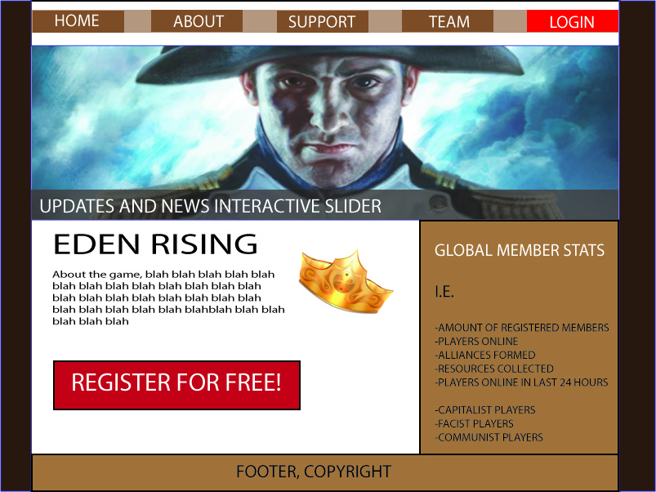
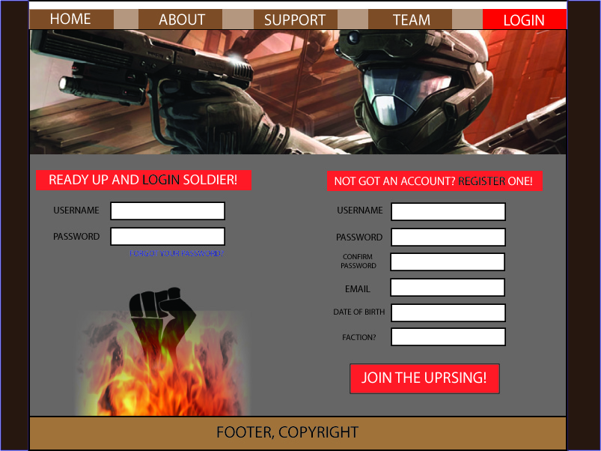
Website Wireframe Concept
Home Page…
Login Page…

Slide 12
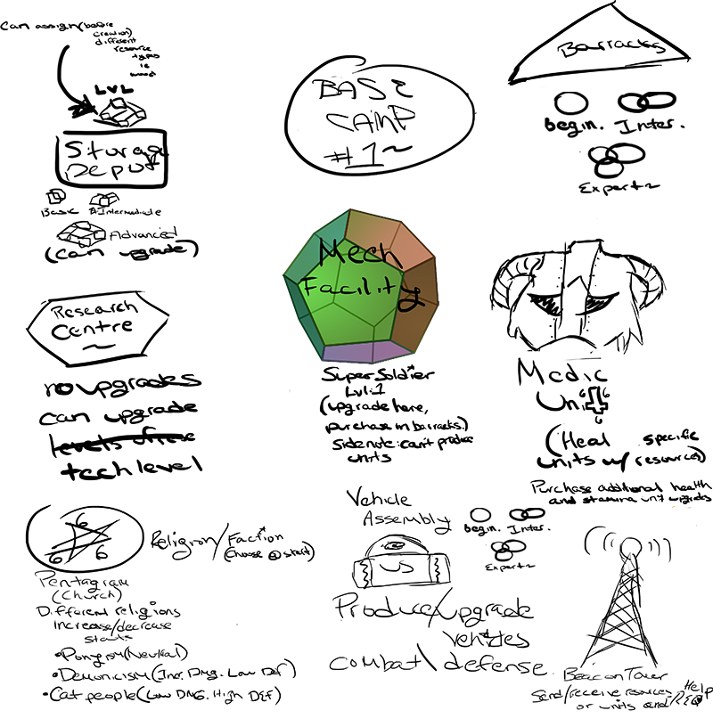
Initial Concept Ideas… (Buildings)

Slide 13
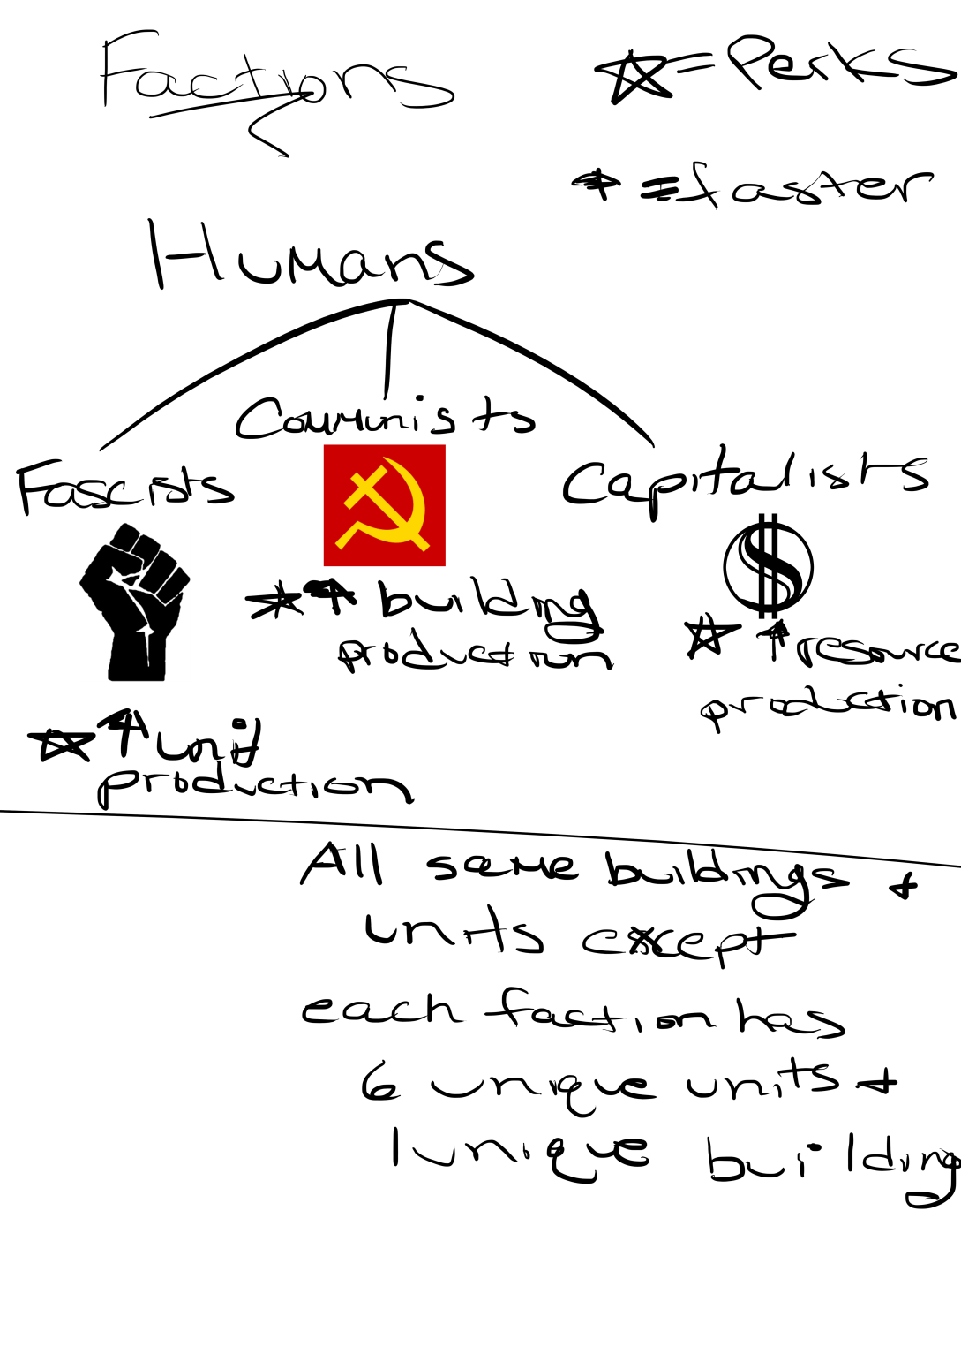
Initial Concept Ideas… (Factions)

Slide 14
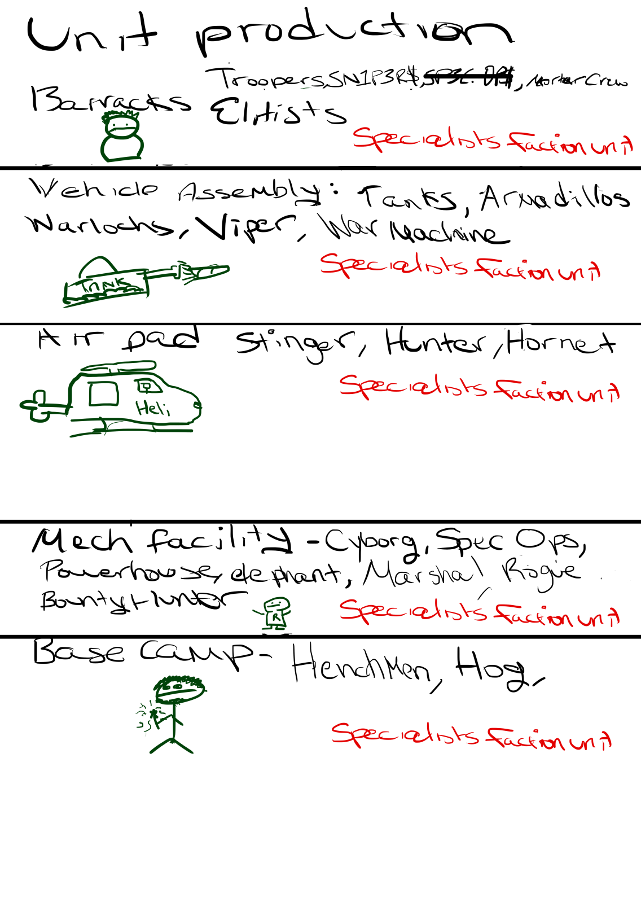
Initial Concept Ideas… (Units)

Slide 15
Building’s List
 | Fascists | Communists | Capitalists
Base Camp
Barracks
Resource Pad
Research Lab
Church
Air Pad
Vehicle Assembly
Mech Facility
Medic Unit
Communications Tower
Storage Depot
Elite Boot Camp
Propaganda Building
Trade Centre

Slide 16
Concept Art - Resource Pad
Graphic Art By: John Greenslade

Slide 17

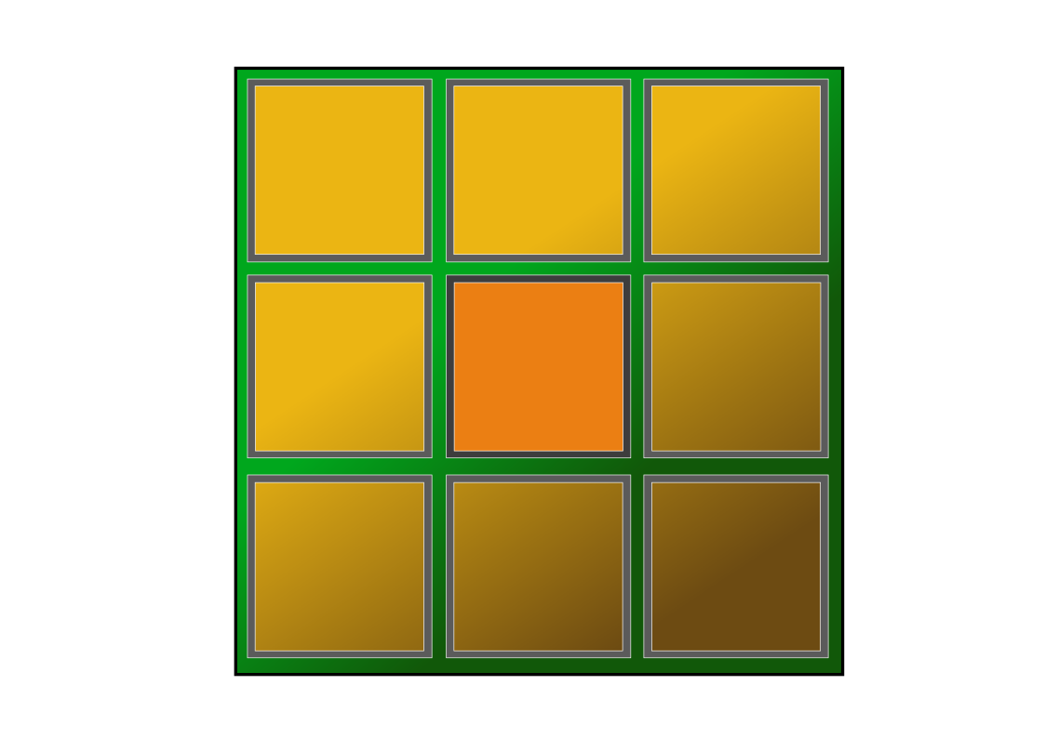

Concept Art - Player Interface
Above is our concept art design of the player interface that the user will use for building structures on their main base/town. The middle square is the centre of the main base where the player will start of by constructing their base camp, players can then construct other structures around the base camp such as a barracks, resource pads and a range of other structures.
Graphic Art By: John Greenslade
Concept Art - Player Interface
Graphic Art By: John Greenslade

Slide 18

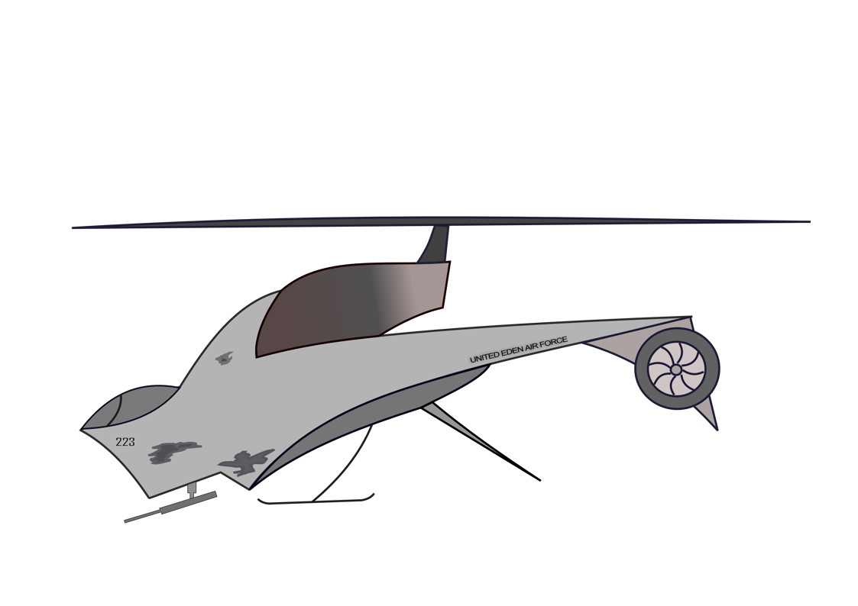
Concept Art - Air Resource Collector
Graphic Art By: John Greenslade

Slide 19
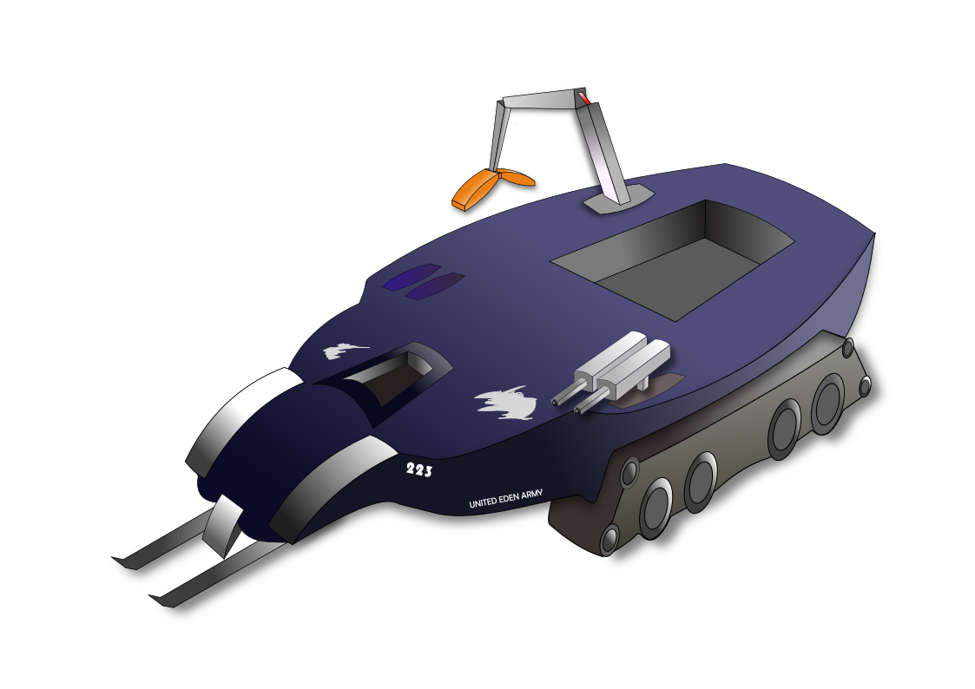

Concept Art - Ground Resource Collector
Graphic Art By: John Greenslade

